Slide 1
Devoxx France 2017
sample presentation
Nicolas Martignole @nmartignole
Zouheir Cadi @zouheircadi
Antonio Goncalves @agoncal

Slide 2
Welcome to Devoxx France
This is a template for Keynote
16/9

Slide 3

We love picture
We try to keep the Devox France logo and the Tweet hashtag on all slides

Slide 4
Roadmap
This is a slide without background images.
You must load and install 2 Fonts on your system :
Montserrat (https://www.fontsquirrel.com/fonts/montserrat)
Open Sans (https://www.fontsquirrel.com/fonts/open-sans)

Slide 5
Devoxx FR 2018 colors
- main color, dark red, #7f1111
- secondary color, light pink red blue, #FF1c4c
- third color, red #FF1417
- alternate color, accent, #DB1837
- alternate color 2, #cc0c0c

Slide 6
Devoxx FR 2017 colors

Slide 7
Show me shome code !
Try to keep a font size as big as possible. Remember also that too much code on one slide is useless. The audience reads this texte and does not listen to your presentation anymore. Try to split on different slides your presentation.
If you show some code : BIG FONT please
Ask the audience i

Slide 8
Step 1 : add to Redis sorted set
127.0.0.1:6363[2]> zadd hackers 1953 "Richard Stallman"
(integer) 1
127.0.0.1:6363[2]>
127.0.0.1:6363[2]> zadd hackers 1969 "Linus"
(integer) 1
127.0.0.1:6363[2]> zadd hackers 1912 "Alan turing"
(integer) 1

Slide 9
Step 2 : Show the list of Hackers
127.0.0.1:6363[2]> zadd hackers 1953 "Richard Stallman"
(integer) 1
127.0.0.1:6363[2]>
127.0.0.1:6363[2]> zadd hackers 1969 "Linus"
(integer) 1
127.0.0.1:6363[2]> zadd hackers 1912 "Alan turing"
(integer) 1
127.0.0.1:6363[2]> zrange hackers 0 -1
1) "Alan turing"
2) "Richard Stallman"
3) "Linus"

Slide 10
Step 3 : Show the list with score
127.0.0.1:6363[2]> zadd hackers 1953 "Richard Stallman"
(integer) 1
127.0.0.1:6363[2]>
127.0.0.1:6363[2]> zadd hackers 1969 "Linus"
(integer) 1
127.0.0.1:6363[2]> zadd hackers 1912 "Alan turing"
(integer) 1
127.0.0.1:6363[2]> zrange hackers 0 -1
1) "Alan turing"
2) "Richard Stallman"
3) "Linus"
127.0.0.1:6363[2]> zrange hackers 0 -1 withscores
1) "Alan turing"
2) "1912"
3) "Richard Stallman"
4) "1953"
5) "Linus"
6) "1969"

Slide 11
Step 4 : Last step with transparent code
127.0.0.1:6363[2]> zadd hackers 1953 "Richard Stallman"
(integer) 1
127.0.0.1:6363[2]>
127.0.0.1:6363[2]> zadd hackers 1969 "Linus"
(integer) 1
127.0.0.1:6363[2]> zadd hackers 1912 "Alan turing"
(integer) 1
127.0.0.1:6363[2]> zrange hackers 0 -1
1) "Alan turing"
2) "Richard Stallman"
3) "Linus"
127.0.0.1:6363[2]> zrange hackers 0 -1 withscores
1) "Alan turing"
2) "1912"
3) "Richard Stallman"
4) "1953"
5) "Linus"
6) "1969"
127.0.0.1:6363[2]> zrangebyscore hackers 1910 1940
1) "Alan turing"

Slide 12
Live Demo

Slide 13
Merci / Thanks you

Slide 14

Facts
Devoxx France 2018
231 speakers with a badge, 60 exhibitors
and more than 3000 attendees

Slide 15
Less code is less bug

Slide 16
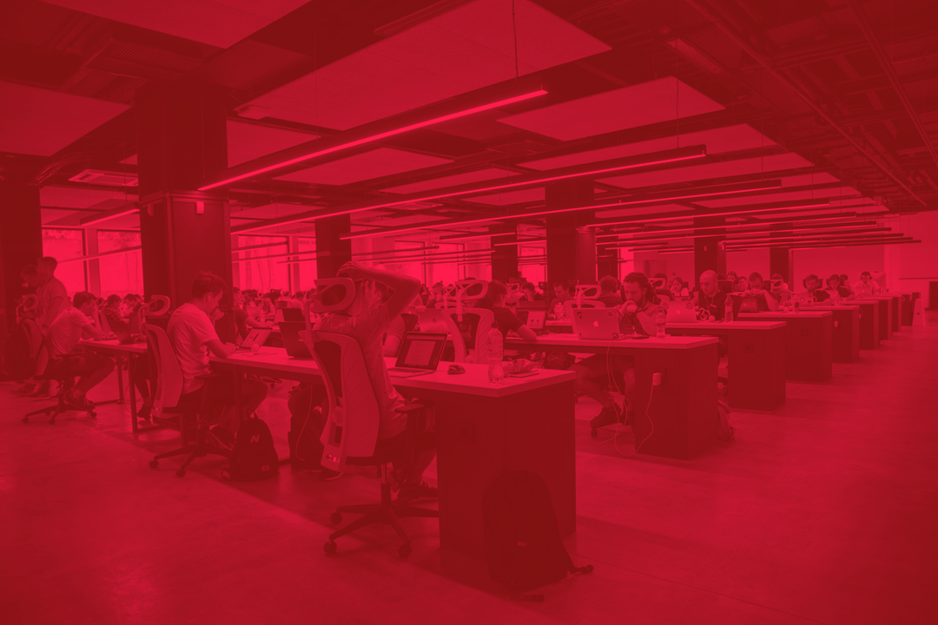

Slide 17


Slide 18
Why less slides is better than more slides
Devoxx France runs on 3 days
Audience loves live coding and demo
Too much bullet points is super boring
More text : less concentration from the audience that will just read your slides
So this is exactly what you should not do

Slide 19
Pourquoi peu de diapositives c’est mieux
Devoxx France se déroule sur 3 jours
Le public préfère les démonstrations et l’écriture de code en direct
Trop de points avec des puces c’est ennuyant
Plus il y a de texte à lire sur vos diapos, moins l’audience vous écoute
Si vos slides peuvent vous remplacer, alors vous ne servez à rien comme orateur
Imaginez que votre ensemble de diapos ne doivent pas pouvoir vivre sans vous, sans votre présentation et votre contenu
Merci donc de ne PAS faire comme ce slide à mourir

Slide 20

Toujours plus d'image
Les diagrammes dynamiques c’est vraiment top
Allez sur le site duotone.shapefactory.co/
Prenez 2 des couleurs de Devoxx FR 2018
Et passez vos images en 2 tons…
c’est beau !!

Slide 21
Screen capture
https://cfp.devoxx.fr

Slide 22
Here are just a few photos from Devoxx France so that you get a better idea of what you’re about to live
Voici quelques photos de Devoxx France afin de vous donner une idée de ce que vous vous apprêtez à vivre…

Slide 23
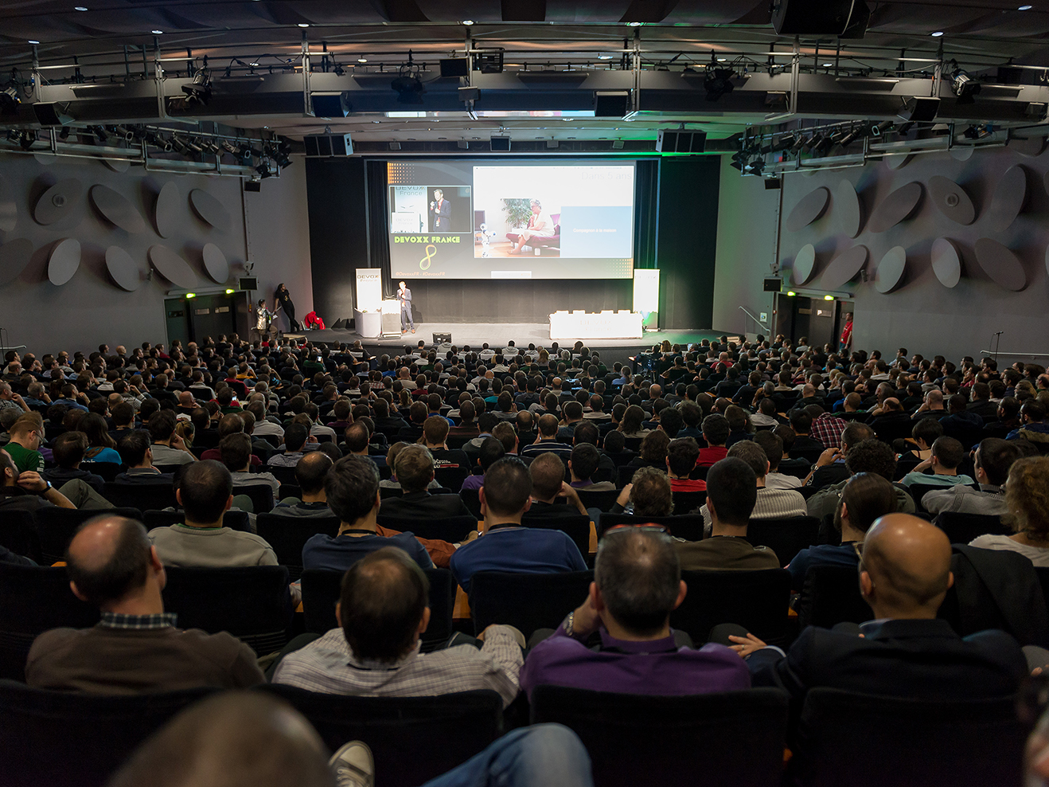
2015

Slide 24
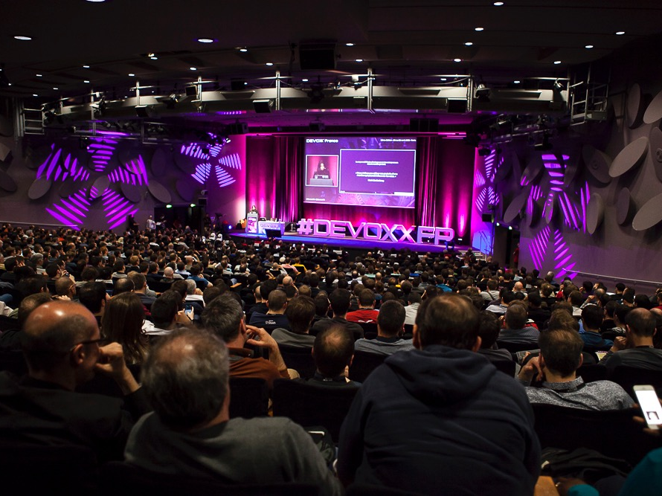
2016

Slide 25
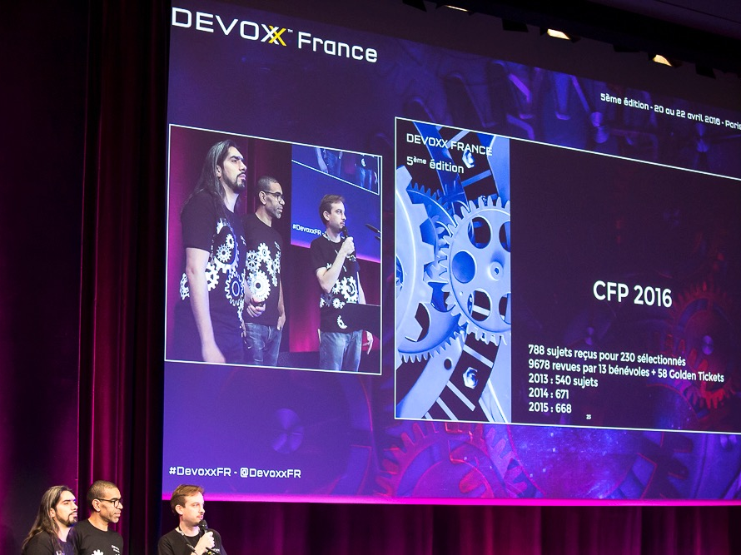

Slide 26
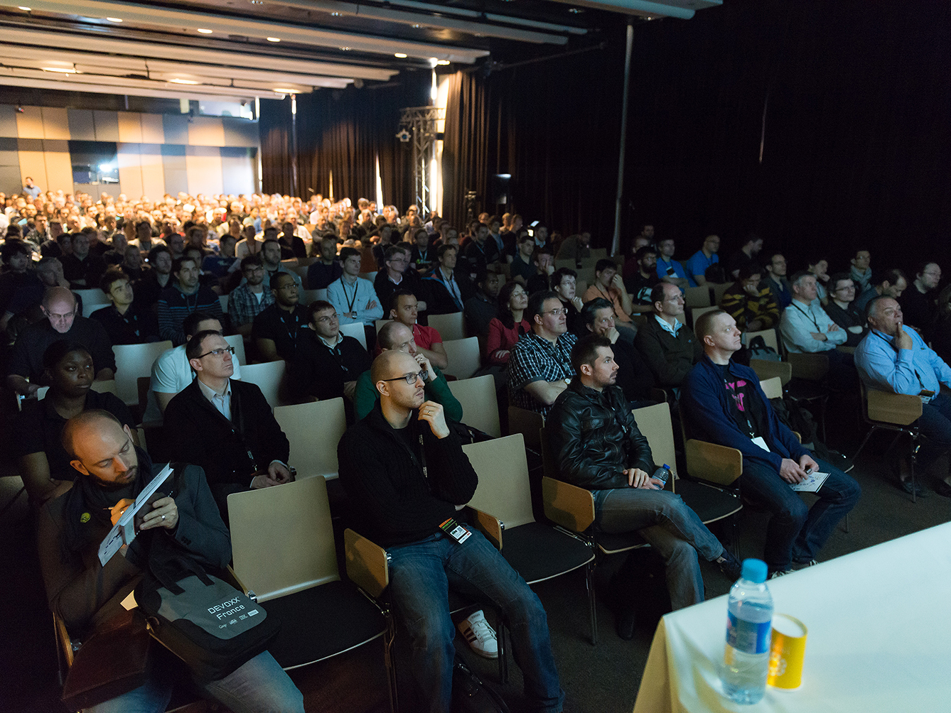

Slide 27
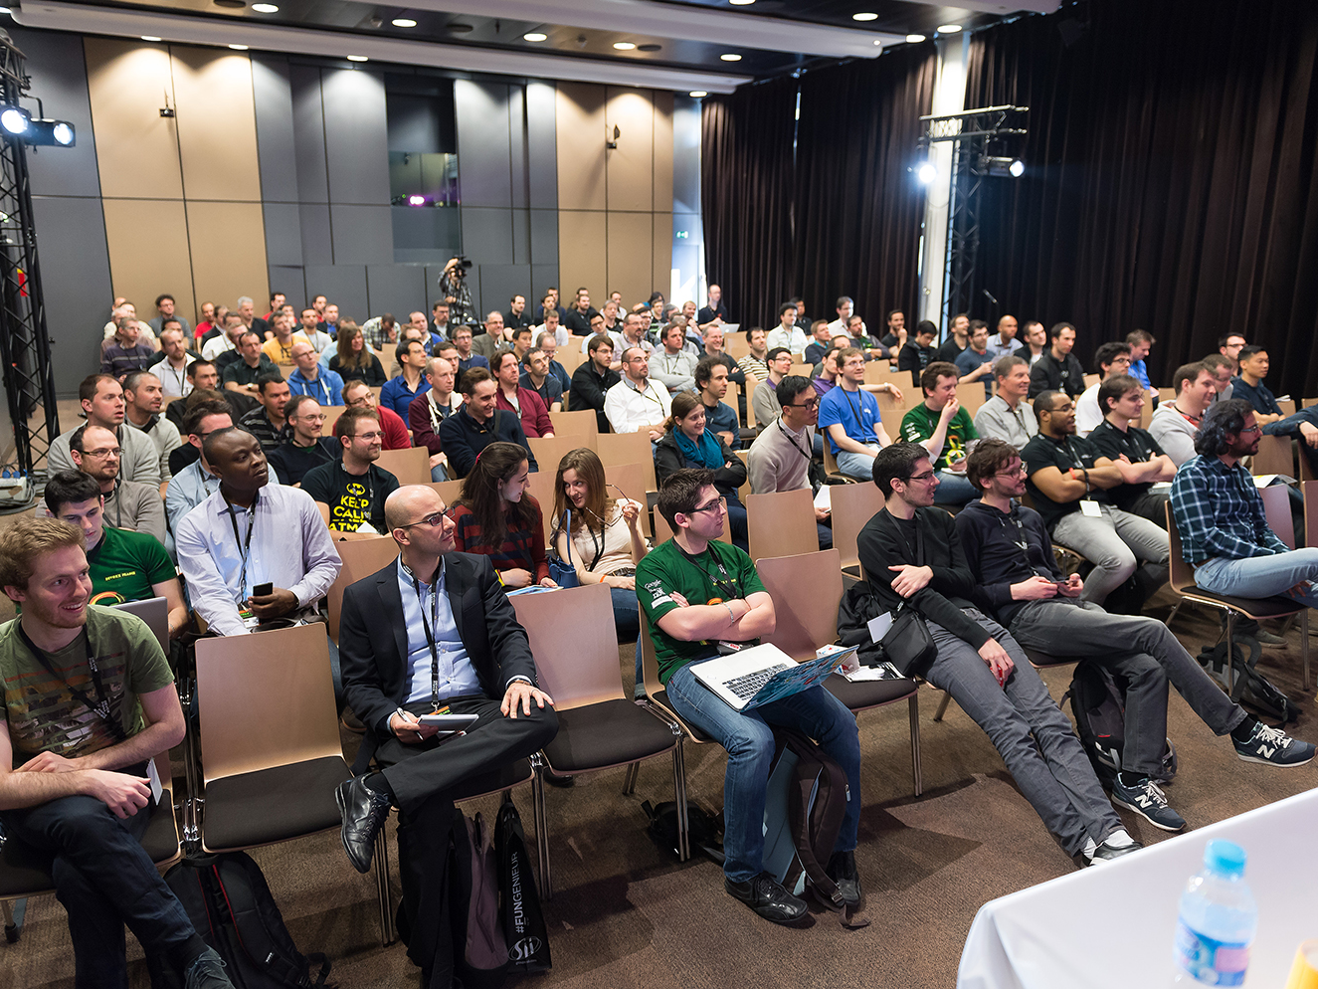

Slide 28
Thanks
Contribute and propose other templates on
https://bitbucket.org/nicolas_martignole/devoxxfr_templates

